Slide 1

Lecture 5:
DC & Transient Response

Slide 2
Outline
Pass Transistors
DC Response
Logic Levels and Noise Margins
Transient Response
RC Delay Models
Delay Estimation
5: DC and Transient Response

Slide 3
Transistor Operation
Current depends on region of transistor behavior
For what V_{in} and V_{out} are nMOS and pMOS in
  Cutoff?
  Linear?
  Saturation?
5: DC and Transient Response

Slide 4
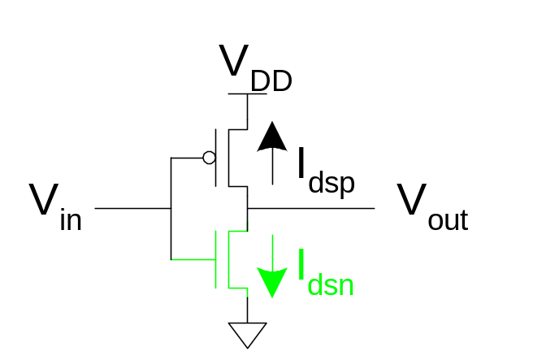
nMOS Operation
Cutoff | Linear | Saturated
V_{gsn} < V_{tn} V_{in} < V_{tn} | V_{gsn} > V_{tn} V_{in} > V_{tn} V_{dsn} < V_{gsn} – V_{tn} V_{out} < V_{in} - V_{tn} | V_{gsn} > V_{tn} V_{in} > V_{tn} V_{dsn} > V_{gsn} – V_{tn} V_{out} > V_{in} - V_{tn}
V_{gsn} = V_{in}
V_{dsn} = V_{out}
5: DC and Transient Response

Slide 5
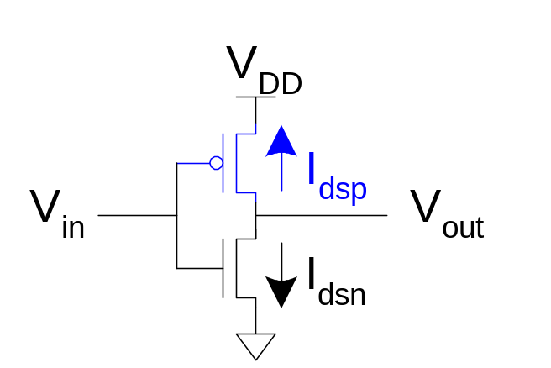
pMOS Operation
Cutoff | Linear | Saturated
V_{gsp} > V_{tp} V_{in} > V_{DD} + V_{tp} | V_{gsp} < V_{tp} V_{in} < V_{DD} + V_{tp} V_{dsp} > V_{gsp} – V_{tp} V_{out} > V_{in} - V_{tp} | V_{gsp} < V_{tp} V_{in} < V_{DD} + V_{tp} V_{dsp} < V_{gsp} – V_{tp} V_{out} < V_{in} - V_{tp}
V_{gsp} = V_{in} - V_{DD}
V_{dsp} = V_{out} - V_{DD}
V_{tp} < 0
5: DC and Transient Response

Slide 6
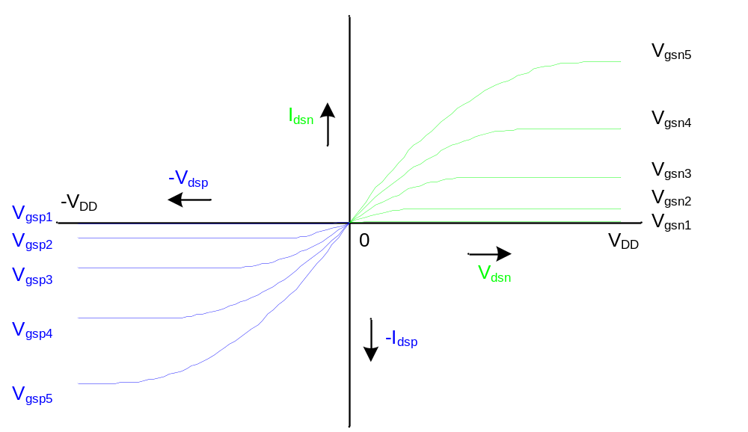
I-V Characteristics
Make pMOS is wider than nMOS such that β_{n} = β_{p}
5: DC and Transient Response

Slide 7
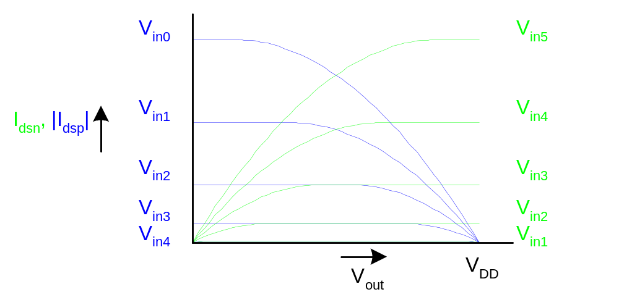
Current vs. V_{out}, V_{in}
5: DC and Transient Response

Slide 8
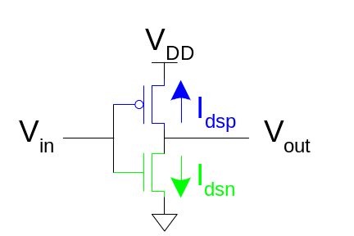
Load Line Analysis
For a given V_{in}:
  Plot I_{dsn}, I_{dsp} vs. V_{out}
  V_{out} must be where |currents| are equal in
5: DC and Transient Response

Slide 9
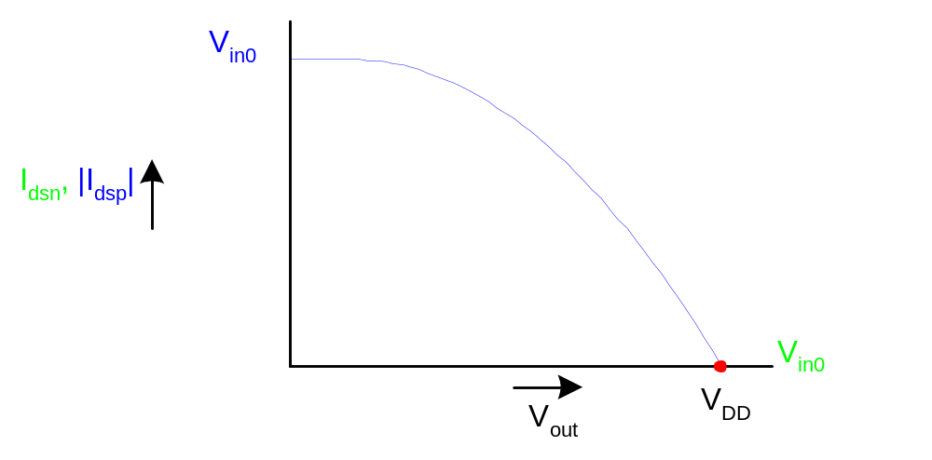
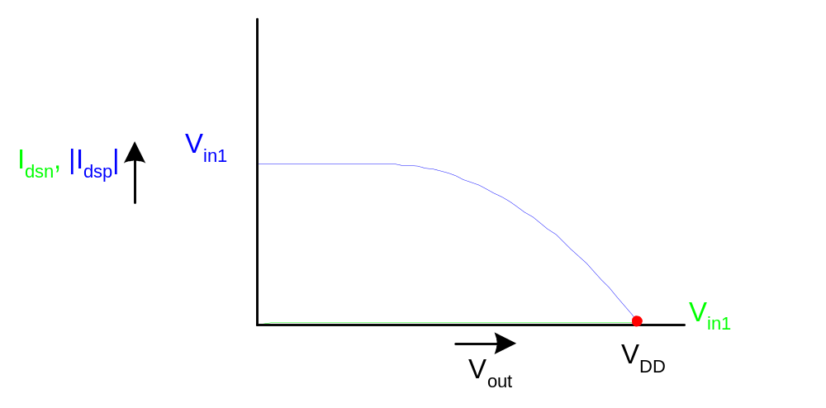
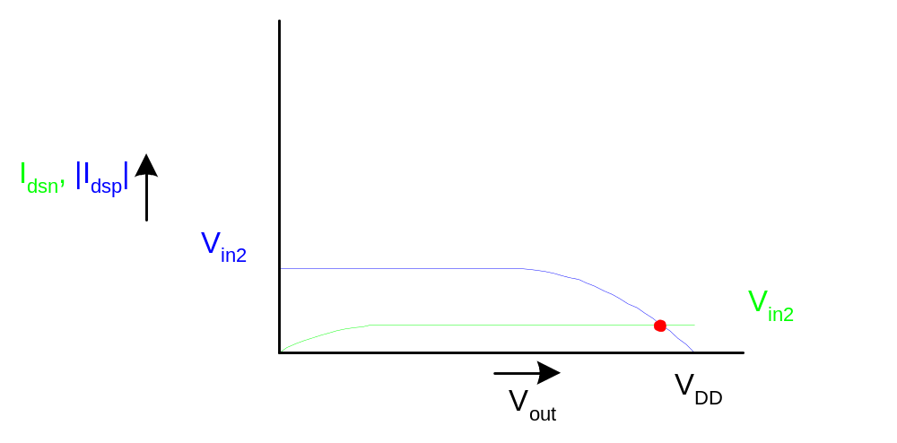
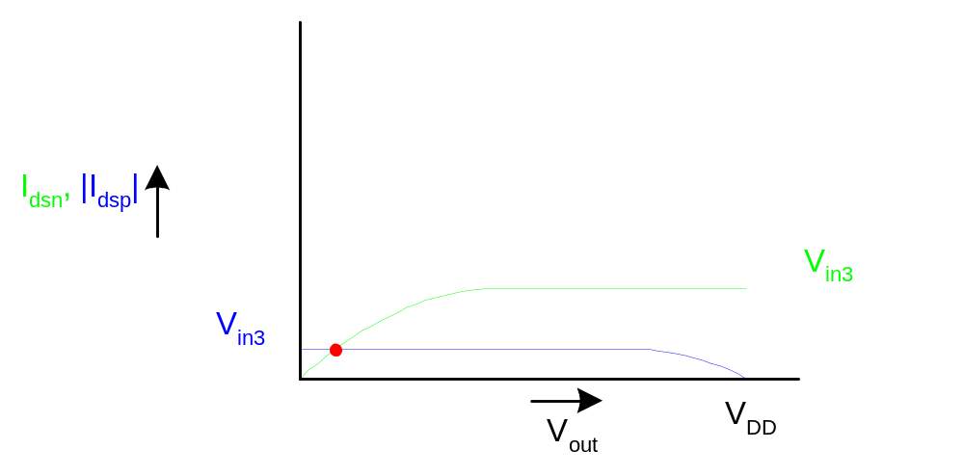
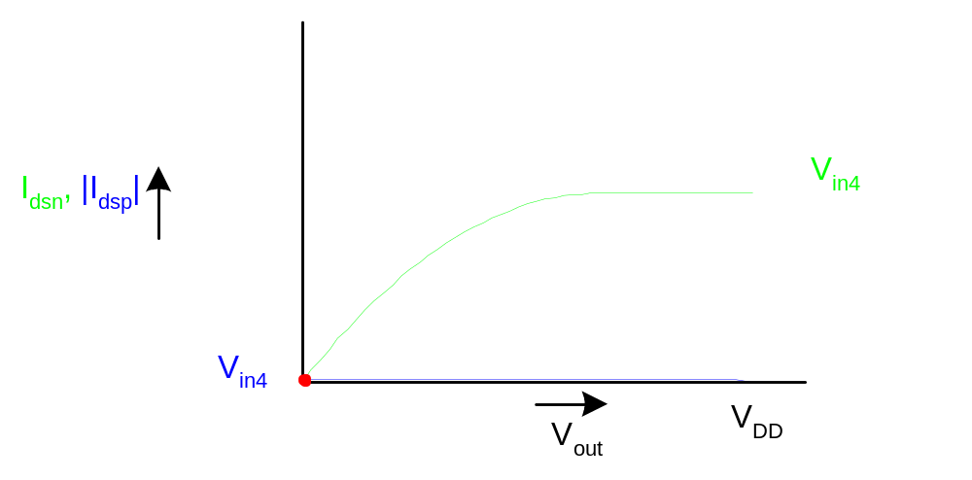
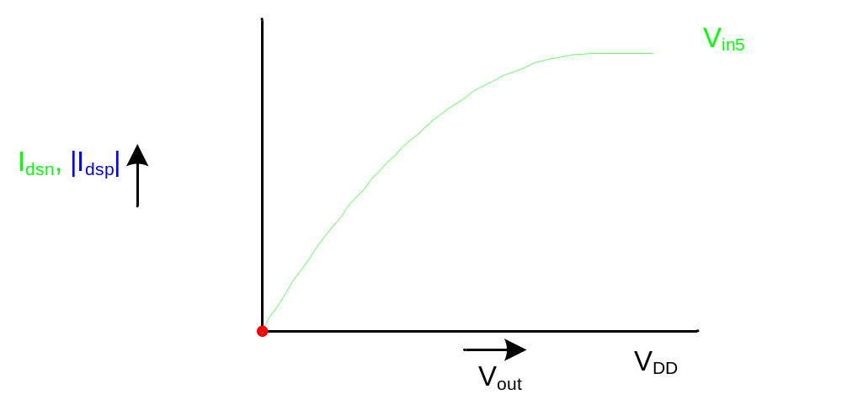
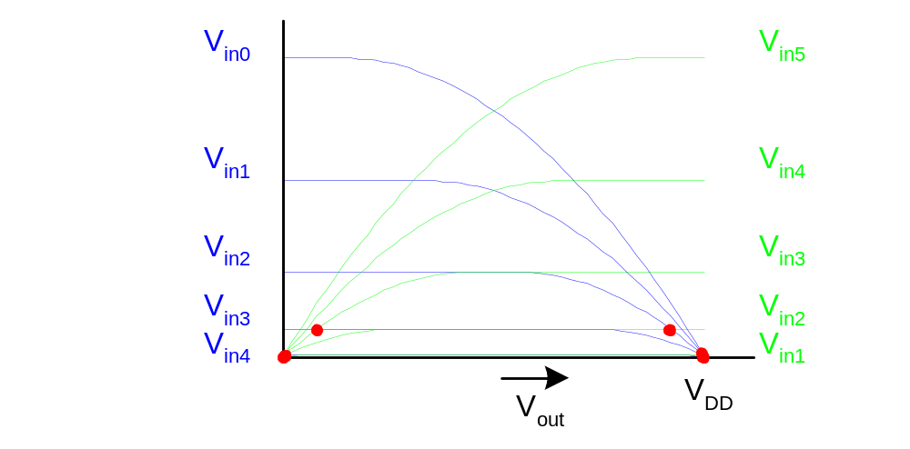
Load Line Analysis
V_{in} = 0
V_{in} = 0
0.2V_{DD}
V_{DD}
0.4V_{DD}
0.6V_{DD}
0.8V_{DD}
5: DC and Transient Response

Slide 10
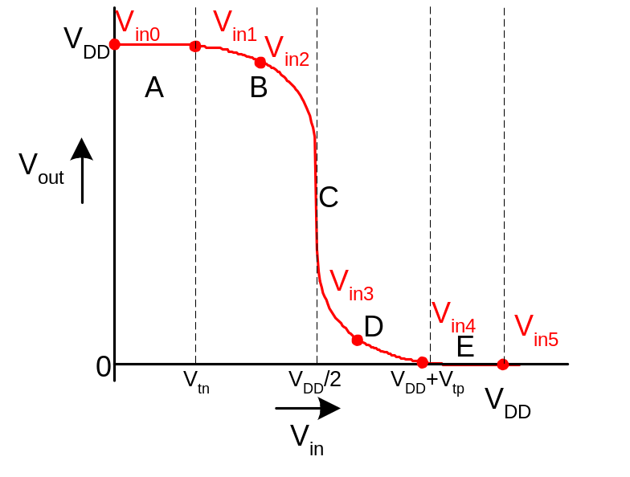
DC Transfer Curve
Transcribe points onto V_{in} vs. V_{out} plot
5: DC and Transient Response

Slide 11
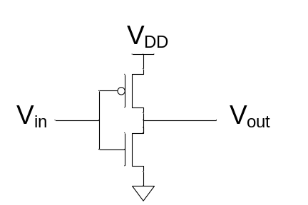
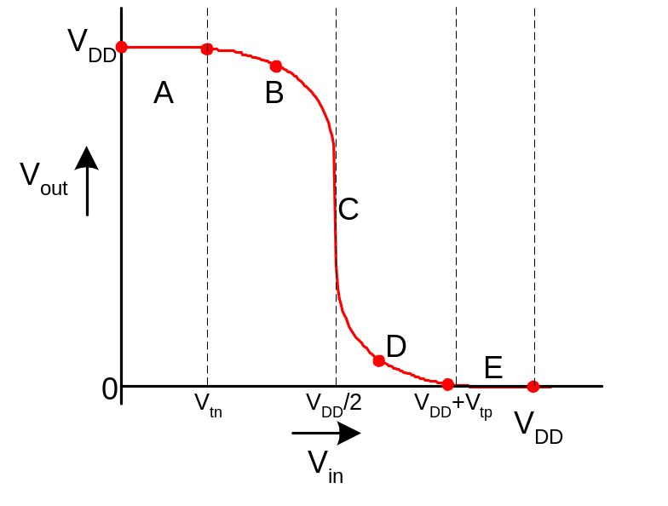
Operating Regions
Revisit transistor operating regions
Region | nMOS | pMOS
A | Cutoff | Linear
B | Saturation | Linear
C | Saturation | Saturation
D | Linear | Saturation
E | Linear | Cutoff
5: DC and Transient Response

Slide 12
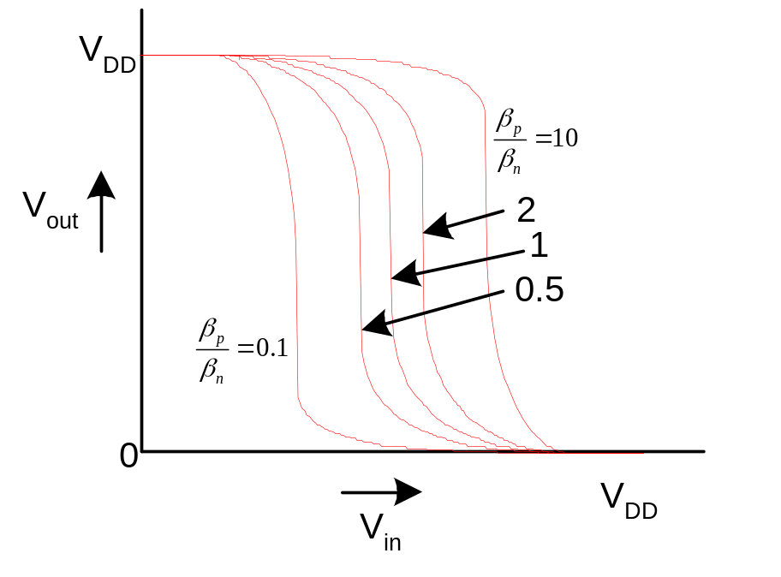
Beta Ratio
If β_{p} / β_{n} ≠ 1, switching point will move from V_{DD}/2
Called skewed gate
Other gates: collapse into equivalent inverter
5: DC and Transient Response

Slide 13
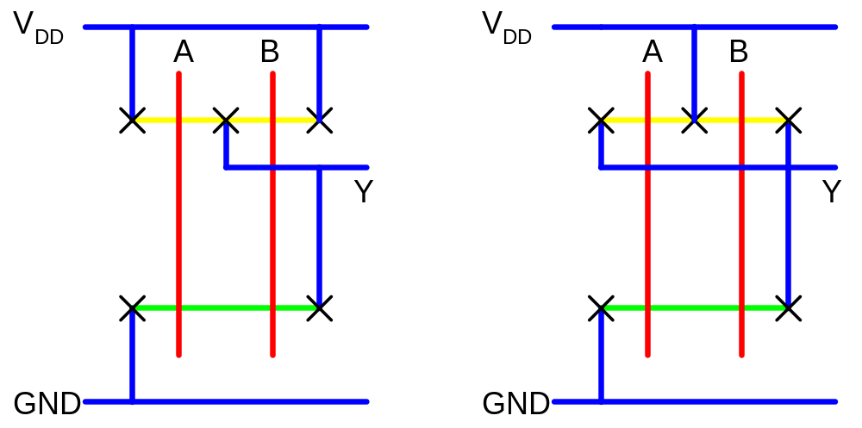
Layout Comparison
Which layout is better?
5: DC and Transient Response

